Slide 1
It is time to go back to school!
Insert a photo of your school here.

Slide 2
My school has been closed because of the COVID germ.
Your School

Slide 3
My school is now clean and has no germs!
Your School

Slide 4
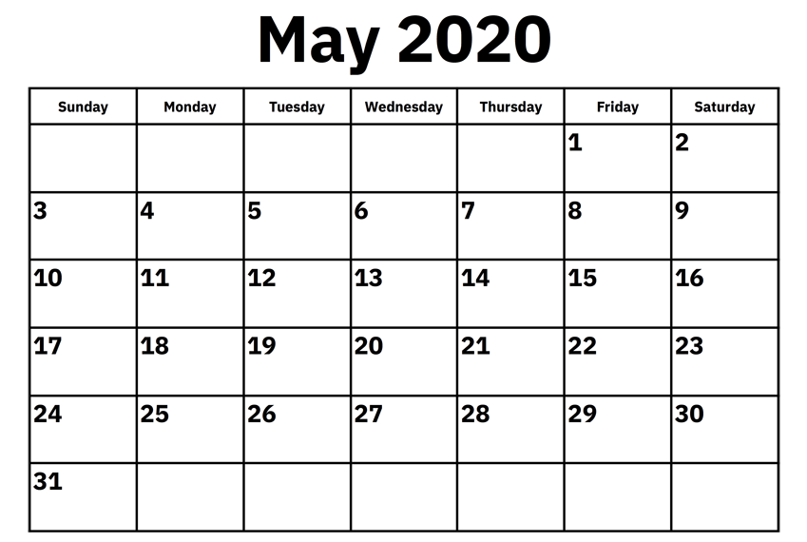
On 26 May 2020 my friends and I are going back to school!
I cannot wait to see everybody.
Your
school
logo

Slide 5
Your Teachers
Your Friends
My teachers and friends will be happy to see me.

Slide 6
Your workbook and other photos.
I will show my teachers and friends what I have done at home.

Slide 7
A photo of you washing your hands.
I will wash my hands when I am at school.

